Slide 1
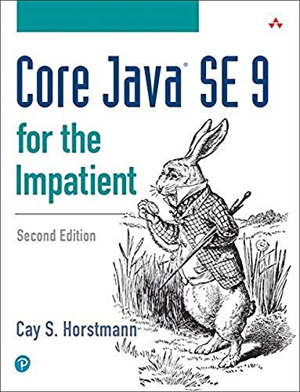
Object-Oriented Programming and Data Abstraction Lesson 4: Lambda Expressions
Sections 3.4 – 3.7
Notes:
Replace this with your course title and your name/contact details.

Slide 2
Lambda functions / expressions
A lambda function is a function that you can write inline in your source code (usually to pass in to another function, similar to the idea of a functor or function pointer).
Inline: It does not need a function header
Languages like JavaScript have used lambda functions for quite some time
Java introduces them in Java 8 as "lambda expressions"

Slide 3
Decyphering a Lambda Expression
Lambda expressions take this form:
Think of A as the input (like input parameters of a method)
Think of B as either the output or the action
Output would be like the return type of a method
Action would be a more appropriate word when there is no return type; i.e., for void methods
A -> B
input
output or action

Slide 4
A look back at compareTo()
In previous slides we have seen the Comparable interface which enforced the compareTo() method implementation.
But as we had previously said, this only gives us one way to compare objects
public class Book implements Comparable<Book> {
@Override
public int compareTo(Book b) {
// Compare alphabetically by title, then by author
int compare = this.title.compareTo(b.getTitle());
if (compare != 0) {
// The books have different String titles
return compare;
}
else {
// Let's compare by author
compare = this.author.compareTo(b.getAuthor());
return compare;
}
}

Slide 5
Onto Comparator
public class Book implements Comparator<Book> {
@Override
public int compare(Book book1, Book book2) {
// Compare alphabetically by title, then by author
// Note: we are still using compareTox().
// Why not? compareTo() for Strings will compare alphabetically
int compare = book1.getTitle().compareTo(book2.getTitle());
if (compare != 0) {
// The books have different String titles
return compare;
}
else {
// Let's compare by author
compare = book1.getAuthor().compareTo(book2.getAuthor());
return compare;
}
}
Not much different, eh? So what's the big deal?

Slide 6

The Big Deal
…And here are some of the Comparators
Comparator<Book> sortByYearAsc = (b1, b2) -> b1.getPublicationYear() – b2.getPublicationYear();
Comparator<Book> sortByYearDesc = (b1, b2) -> b2.getPublicationYear() – b1.getPublicationYear();
Comparator<Book> sortByAuthor = (b1, b2) -> b1.getAuthor().compareTo(b2.getAuthor());
// Use the ternary operator for fancy // two-level sorting
Comparator<Book> sortByYearDescTitle =
(b1, b2) -> b2.getPublicationYear() – b1.getPublicationYear() == 0
? b1.getTitle().compareTo(b2.getTitle())
: b2.getPublicationYear() b1.getPublicationYear();
When Book implemented the Comparator interface, it provided a default way to sort books by defining the compare() method.
But, the Book class can also have a bunch of Comparators to allow for flexible sorting!
Here's a static HashMap in the class Book, where the key is a String and the value is a Comparator of Books
public static final HashMap<String, Comparator<Book>> comparators =
new HashMap<String, Comparator<Book>>();
http://jackmyers.info/oopda/src/Lesson-04/comparator/

Slide 7
Some examples
static List<Book> bookSet = new ArrayList<Book>();
public static void main(String[] args) {
populateCollecions();
displayBooks();
Comparator<Book> comparator = getComparatorChoice();
bookSet.sort(comparator);
displayBooks();
}
private static Comparator<Book> getComparatorChoice() {
Scanner sc = new Scanner(System.in);
Book.comparators.keySet().forEach(key -> System.out.println(key));
System.out.println("\nChoose your sorting comparator");
String choice = sc.next();
return Book.comparators.get(choice);
}
Also see example at https://www.geeksforgeeks.org/comparator-interface-java/?ref=lbp

Slide 8
Lambda Expressions
A lambda expression is like an anonymous function.
Such anonymous functions do not have:
Access Modifiers
Names
Declaration of Return Type
private String getZodiacIcon(String zodiacSign) {
// Returns the icon name, e.g. "Archer" for "Sagitarius"
}
By using lambda expressions, you can write local functions that can be passed as arguments or returned as the value of function calls.
X
X
X

Slide 9
Syntax Rules for Lambda Expressions
A lambda expression can have zero, one or more parameters.
The type of the parameters can be explicitly declared or it can be inferred from the context. e.g. (int a) is same as just (a)
Parameters are enclosed in parentheses and separated by commas. e.g. (a, b) or (int a, int b) or (String a, int b, float c)
Empty parentheses are used to represent an empty set of parameters. e.g. () -> 42
When there is a single parameter, if its type is inferred, it is not mandatory to use parentheses. e.g. a -> return a*a
The body of the lambda expressions can contain zero, one or more statements.
If body of lambda expression has single statement curly brackets are not mandatory and the return type of the anonymous function is the same as that of the body expression.
When there is more than one statement in body than these must be enclosed in curly brackets (a code block) and the return type of the anonymous function is the same as the type of the value returned within the code block, or void if nothing is returned.

Slide 10
Before we fully understand lambdas… Let's see how familiar code can be transformed

Slide 11
Java Before and After Lambdas: Displaying a Collection
The Traditional Way
public void displaySigns() {
for (ZodiacSign sign : signs) {
System.out.println(sign);
}
}
The Lambda Way
public void displaySigns_wLambdas() {
signs.forEach(sign -> System.out.println(sign));
}

Slide 12
Java Before and After Lambdas: Adding an ActionListener
The Traditional Way
cboOne.addActionListener(new ActionListener() {
@Override
public void actionPerformed(ActionEvent e) {
lblTwo.setText("You selected " + cboOne.getSelectedItem().toString());
}
});
The Lambda Way
cboOne.addActionListener(
event -> lblTwo.setText("You selected " + cboOne.getSelectedItem().toString())
);

Slide 13
Java Before and After Lambdas: Searching a Collection
public ZodiacSign determineSign(Date birthdate) throws ParseException {
Date comparisonDate = getZodiacYearBirthDate(birthdate);
for (ZodiacSign sign : signs) {
if (!comparisonDate.before(sign.getStartDate()) &&
!comparisonDate.after(sign.getEndDate())) {
// This is your sign
return sign;
}
}
return null;
}
public ZodiacSign determineSign_wLambda(Date birthdate) throws ParseException {
Date comparisonDate = getZodiacYearBirthDate(birthdate);
Predicate<ZodiacSign> inRange =
s -> !comparisonDate.before(s.getStartDate()) &&
!comparisonDate.after(s.getEndDate());
return signs.parallelStream()
.filter(inRange)
.findAny()
.get();
}

Slide 14




A Calculator Consisting of Lambda Expressions
public class Calculator {
public static void main(String[] args) {
Calculator myApp = new Calculator();
IntegerMath addition = (a, b) -> a + b;
IntegerMath subtraction = (a, b) -> a - b;
System.out.println("40 + 2 = " + myApp.operateBinary(40, 2, addition));
System.out.println("20 - 10 = " + myApp.operateBinary(20, 10, subtraction));
}
// An inner interface! (like an inner class...)
interface IntegerMath {
// This could be considered a "functional interface"
// because it only defines a single method.
int operation(int a, int b);
}
public int operateBinary(int a, int b, IntegerMath op) {
return op.operation(a, b);
}
}
We are passing functions as parameters!

Slide 15
Functional Interfaces and their Functional Methods

Slide 16
Functional Interfaceo
A functional interface is an interface that defines only one method.
Comparable – defines compareTo()
Comparator – defines compare()
You can make your own functional interfaces, as we did with IntegerMath
Java provides us with some very useful functional interfaces:
Predicate, BiPredicate, Function, BiFunction, Consumer, BiConsumer
These are often expected as parameters
You can assign a lambda expression to a functional interface or you could use a method reference.
Class::instanceMethod
Class::staticMethod
object::instanceMethod
Class::new (to reference constructor)
Some Examples
String::compareToIgnoreCase
Person::getDateOfBirth
joe::getSalary
Person::new

Slide 17
Functional Interfaces and their Methods
Some important functional interfaces
Interface | Description | Functional Method
Runnable | Represents an operation that accepts no input arguments and returns no result. | Functional method: run void run()
Supplier<R> | Represents an operation that accepts no input arguments and returns an object of type R. | Functional method: get R get()
Consumer<T> | Represents an operation that accepts a single input argument and returns no result. | Functional method: accept void accept(T t)
BiConsumer<T,U> | Represents an operation that accepts two input arguments and returns no result. | Functional method: accept void accept(T t, U u)
Function<T,R> | Represents a function that accepts one argument and produces a result. | Functional method: apply R apply(T t)
BiFunction<T,U,R> | Represents a function that accepts two arguments and produces a result. | Functional method: apply R apply(T t, U u)
Predicate<T> | Represents a predicate (boolean-valued function) of one argument. | Functional method: test boolean test(T t)
BiPredicate<T,U> | Represents a predicate (boolean-valued function) of two arguments. | Functional method: test boolean test(T t, U u)

Slide 18
Examples

Slide 19
Explicit Calls look for functional methods get() and run()
public static void main(String[] args) {
// Use method which takes a Runnable as a parameter
repeat(10, () -> System.out.print("+"));
// Make a new reference book using a Supplier in the Book class
Book referenceBook = Book.referenceBookSupplier.get();
System.out.println(referenceBook);
}
private static void repeat(int n, Runnable action) {
for (int i = 0; i < n; i++) action.run();
}
public class Book {
private String title;
private String author;
public static Supplier<Book> referenceBookSupplier =
() -> new Book("<Title>", "<Author>", null, null, BookType.REFERENCE);
Driver class
Book class

Slide 20
Explicit Calls look for functional methods test(), accept() and apply()
Consumer<Employee> giveRaise = emp -> emp.setSalary(emp.getSalary() * RAISE); Employee john = new Employee("John", "Sales", 80000); giveRaise.accept(john);
Predicate<Person> katy = person -> person.getFirstName().equalsIgnoreCase("katy");
Person mixon = new Person("Katy", "Mixon");
System.out.println("Is Ms. Mixon a Katy? " + katy.test(mixon));
public class CalculatorUsingBiFunction {
public static void main(String[] args) {
Calculator myApp = new Calculator();
BiFunction<Integer, Integer, Integer> addition =
(a, b) -> a + b;
BiFunction<Integer, Integer, Integer> subtraction =
(a, b) -> a - b;
System.out.println("Calculator using BiFunctions\n");
System.out.println("40 + 2 = " + addition.apply(40, 2));
System.out.println("20 - 10 = " + subtraction.apply(20, 10));
}
}
A simpler version of Calculator using BiFunction

Slide 21
Functional Interfaces: Consumer<T> (1)
Consumer<T> | Represents an operation that accepts a single input argument and returns no result. | Functional method: accept void accept(T t)
Functional interfaces can be represented using lambda expressions.
Consumer<Employee> giveRaise = emp -> emp.setSalary(emp.getSalary() * RAISE); // Input -> Action (can be single statement or block)
Consumer<Employee> giveBonus = emp -> emp.setSalary( emp.getDept().equals("IT") ? emp.getSalary() * BONUS_RAISE : emp.getSalary() );
What does giveBonus do?
the interface
the instance of the interface
the lambda expression (following the =)

Slide 22
Functional Interfaces: Consumer<T> (2)
Consumer<T> | Represents an operation that accepts a single input argument and returns no result. | Functional method: accept void accept(T t)
Functional interfaces can be utilized by invoking their functional method
Consumer<Employee> giveRaise = emp -> emp.setSalary(emp.getSalary() * RAISE); Employee john = new Employee("John", "Sales", 80000); giveRaise.accept(john); // invoke functional method
Java 8 introduces the method forEach() for the Interface Iterable (which covers Sets, Lists and Maps)
default void forEach(Consumer<? super T> action)
Performs the given action for each element of the Iterable until all elements have been processed or the action throws an exception. /* emps is an ArrayList<Employee> */ emps.forEach(giveRaise); // parameter to forEach is a Consumer emps.forEach(emp -> System.out.println(emp)); // parameter is λ
forEach is void; it cannot return anything

Slide 23

Functional Interfaces: Consumer<T> (3)
Variation 1: Block of code as the action of the lambda
Set<ZodiacSign> fireSigns = new HashSet<ZodiacSign>();
fireSigns.add(new ZodiacSign("Aries", "Ram", LocalDate.of(2015,21,3), LocalDate.of(2015,4,19)));
fireSigns.add(new ZodiacSign("Leo", "Lion", LocalDate.of(2015,7,23), LocalDate.of(2015,8,22)));
fireSigns.add(new ZodiacSign("Sagittarius", "Archer", LocalDate.of(2015,11,22), LocalDate.of(2015,12,21)));
fireSigns.forEach(sign -> {
// Notice this time, we have a block of code to execute for each sign
System.out.print(sign.getName());
switch (sign.getName() {
case "Aries":
System.out.println(", but the relationship with the " +
sign.getIcon() + " won't last long-term.");
break;
case "Leo":
System.out.println(", but " + sign.getIcon() + "s always win.");
break;
case "Sagittarius":
System.out.println("! The " + sign.getIcon() + "s tolerate much.");
break;
}
});

Slide 24

Functional Interfaces: Consumer<T> (4)
Variation 2: Explicit Declarations of Input Arguments
Set<ZodiacSign> fireSigns = new HashSet<ZodiacSign>();
fireSigns.add(new ZodiacSign("Aries", "Ram", LocalDate.of(2015,21,3), LocalDate.of(2015,4,19)));
fireSigns.add(new ZodiacSign("Leo", "Lion", LocalDate.of(2015,7,23), LocalDate.of(2015,8,22)));
fireSigns.add(new ZodiacSign("Sagittarius", "Archer", LocalDate.of(2015,11,22), LocalDate.of(2015,12,21)));
/* "sign" implicitly declared as ZodiacSign,
because that's what's in the Set */
fireSigns.forEach(sign -> System.out.print(sign.getName()));
/* Here we choose to explicitly declare "sign" */
fireSigns.forEach( (ZodiacSign sign) -> System.out.print(sign.getName()));

Slide 25
Lambda Expressions and Variable Scope

Slide 26
Variable Scope
The body of a lambda expression has the same scope as a nested block. The same rules for name conflicts apply.
It is illegal to declare a parameter or a local variable in the lambda that has the same name as a local variable.
int first = 0;
Comparator<String> comp = (first, second) -> first.length() - second.length();
// Error: Variable first already defined

Slide 27
Accessing Variables from outside the Lambda's Scope
A lambda expression has three ingredients:
A block of code
Parameters
Values for the free variables — that is, the variables that are not parameters and not defined inside the code.
public static void repeatMessage(String text, int count) {
Runnable r = () -> {
for (int i = 0; i < count; i++) {
System.out.println(text);
}
}
;
new Thread(r).start();
}
Values of free variables are captured by the lambda expression. Their value can be accessed, but not changed within the lambda
Variables in the lambda:
i local to lambda
count free variable
text free variable

Slide 28
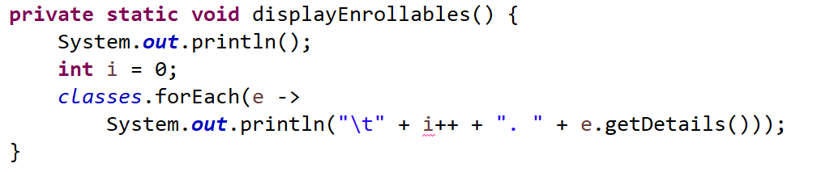

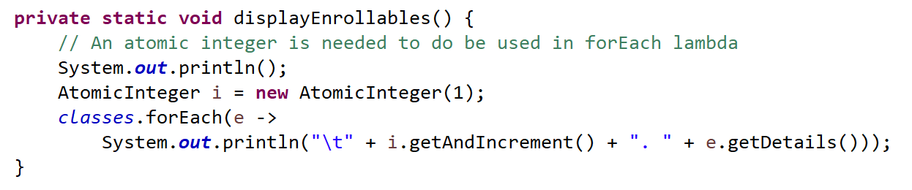
Solution: Atomic Integer
Counter is a free variable; its value cannot be changed.
An AtomicInteger can work, but ONLY in a single thread/process!

